Slide 1
How To Guide- Unite Request
How To Guide-Unite Request
Jared Whelihan
Unite Program Manager

Slide 2
How To Guide-Unite Request
-Jared Whelihan
Unite Program Manager

Slide 3
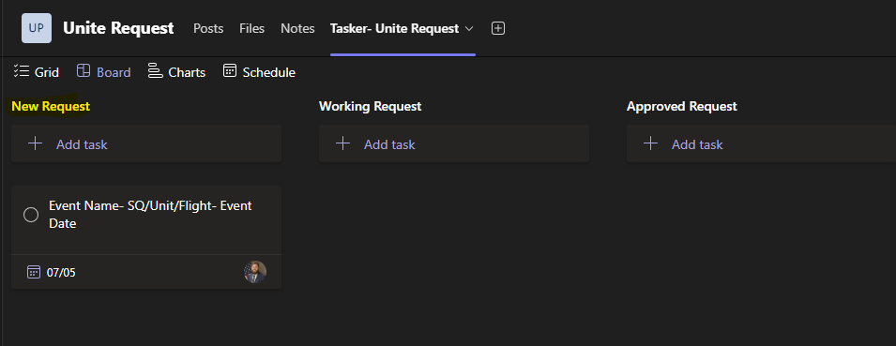
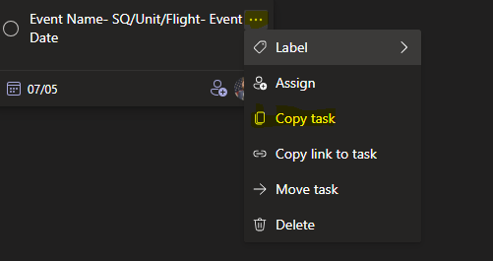
Tasks for Requester
Step 1.) Follow the link to find the Unite Program Teams Folder and go to the Unite Request Channel.
UNITE Program | Unite Request | Microsoft Teams
Step 2.) You will go to the Tasker- Unite Request, there you will create a new task under New Request
Step 3.) You will the example task as shown below, select the three little dots, select Copy task, to create your new task.

Slide 4
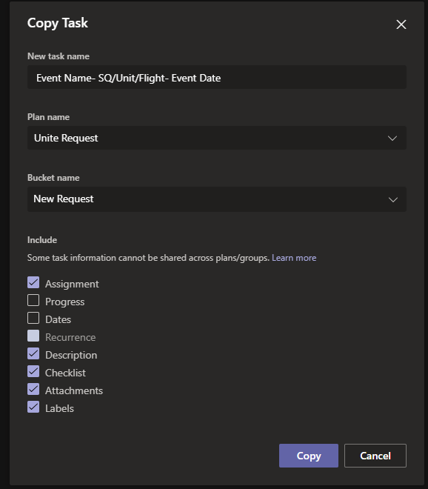
Tasks for Requester
Step 4.) Change Task name, Event Name, Squadron/Unit/Flight & Event Date, then select the Assignment Check Box, and Copy Task.

Slide 5
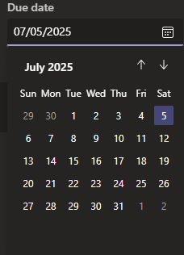
Tasks for Requester
Step 5.) Select and change the “Due Date”
****Due date will be event date it was ordered****

Slide 6
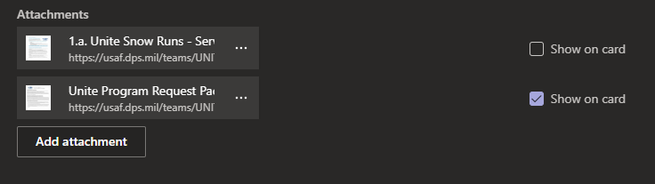
Tasks for Requester
Step 6.) Add the required documents to the tasker. The only document required in this step is the Unite Program Request and the *Unite Snow Runs Agreement*
***Winter Season Only***

Slide 7
Unite POCs
- All Required Files, along with this training are stored within the Files Section of the Unite Request Folder
- You will be notified via TEAMS when there is progress made during your request.
- After you have completed the event, your request will be moved to the Completed Events Task.
- You will be required to submit the After-Action Report, which can be found in the Files Section.
- You are required to submit at a minimum of three photos of your event, in the attachment area.
If you have any questions or concerns, please reach out to Jared Whelihan at jared.whelihan.1@us.af.mil or at 226-3254, or 226-9158

